Slide 1
GENERATIONS OF COMPUTER
KALSOOM INAMULLAH
ZARAFSHA

Slide 2
Computer generations are based on major technological changes in computers . With each new generation, computer circuitry, size, and parts have been miniaturized, the processing and speed doubled, memory got larger, and usability and reliability improved.
There are five generations of computers identified, although the sixth generation could be in development now in the early 21st century.
Our computer journey started in 1940 with the vacuum tubes and goes to the AI (artificial intelligence) system which we use today.

Slide 3
Five Generations of Computers
Generations of computers | Generations timeline | Technology
First generation | 1940s-1950s | Vacuum Tube
Second generation | 1950s-1960s | Transistor
Third generation | 1960s-1970s | Integrated circuit
Fourth generation | 1970s-present | Microprocessor
Fifth generation | The present and the future | Artificial intelligence

Slide 4
First Generation
1940-1956
The first generation of the computer used vacuum tubes for the circuitry and magnetic drums for the memory, and they were often enormous, taking up entire rooms.
These computers were very expensive to operate, uses a great amount of electricity and produced a large amount of heat.
The input was based on the punched cards and the paper tape and the output was displayed on the printouts.
Relied on the lowest-level machine language, in order to perform operations, and could only solve a single problem at a point of time.
In this generation mainly batch processing operating systems were used.
ENIAC, UNIVAC,EDVAC are examples of the first generation of the computer.
The computers of first-generation were managed to use in different fields like weather forecasting, solving mathematical problems, in space research, military, and other scientific tasks.

Slide 5
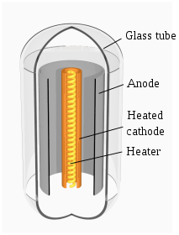
VACUUM TUBES
A vacuum tube or electron tube is a device made of sealed glass containers that controls electric current flow between two electrodes in a high vacuum to which a current has been applied.
Vacuum tubes started and ended the circuitry by switching on and off.
The simplest vacuum tube, the diode was invented in 1904 by John Ambrose Fleming. It contains only a heated electron-emitting cathode and an anode. Electrons can flow in only one direction through the device—from the cathode to the anode.
Electrons from the hot cathode
flow towards the positive anode,

Slide 6
SECOND GENERATION
1956 – 1963
The second generation of computers replaced the vacuum tubes with a reliable component called transistors.
The first transistor was invented in 1947 but didn’t use in the computer till late1950s.
Transistors were smaller than vacuum tubes and allowed computers to be smaller in size, faster in speed, and cheaper to build.
This generation of computers also included hardware advances like magnetic core memory, magnetic tape, and the magnetic disk.
The second generation of computer moved to the symbolic or assembly language from machine language.
The first computer of the second generation was developed for the atomic energy industry.

Slide 7
TRANSISTORS
A transistor is an electronic device that is used in circuits to either amplify or switch electrical signals or power.
The basic idea behind a transistor is that it control the flow of current
It consists of two PN diodes connected back to back. It has three terminals namely emitter, base and collector.
The base serves as a gate controller device for a larger electric supply. The collector is a larger electrical supply and the outlet of that supply is the emitter.
It can work either as an amplifier or a switch:
When it works as an amplifier, it takes in a tiny electric current at one end (an input current) and produces a much bigger electric current (an output current) at the other. In other words, it's a kind of current booster.
Transistors can also work as switches. A tiny electric current flowing through one part of a transistor can make a much bigger current flow through another part of it. In other words, the small current switches on the larger one.

Slide 8
THIRD GENERATION
1964-1971
The third generation appeared in the form of integrated circuits (invented by Jack Kilby from 1958 to 1964).It consists of many small transistors mounted on the silicon chips, which are called semiconductors.
Using IC's in computers helped reduce the size of computers even more than second-generation computers, and also made them faster.
In the third generation of computer user used the keyboards and monitors and interfaced with an OS (operating system) instead of the punched cards and printouts and the computer can run many applications at one time.
This generation of the computer is small, cheaper and reliable than the 1st and 2nd generation.
Use high-level languages like BASIC, COBOL, FORTRAN, PASCAL.

Slide 9
INTEGRATED CIRCUITS
Integrated circuit (IC), also called a chip contain thousand or millions of electronic components such as transistors, resistors, capacitors and more all on a single semiconductor chip(typically silicon).
The two most significant parts of constructing an Integrated Circuit are fabrication and packaging.
The fabrication process involves making or designing the Integrated circuits.
The packaging process of the Integrated Circuits involves encapsulation or assembly, and is the last stage of making the chips.
Three types of ICS: Digital ICs, Analog ICs, Mixed Signal ICs.
Digital ICS is used in binary and logical operations. Analog ICs is used for continuous signal processing. Mixed Signal ICs combine digital and analog functions, found in devices like smartphones and data convertors.

Slide 10
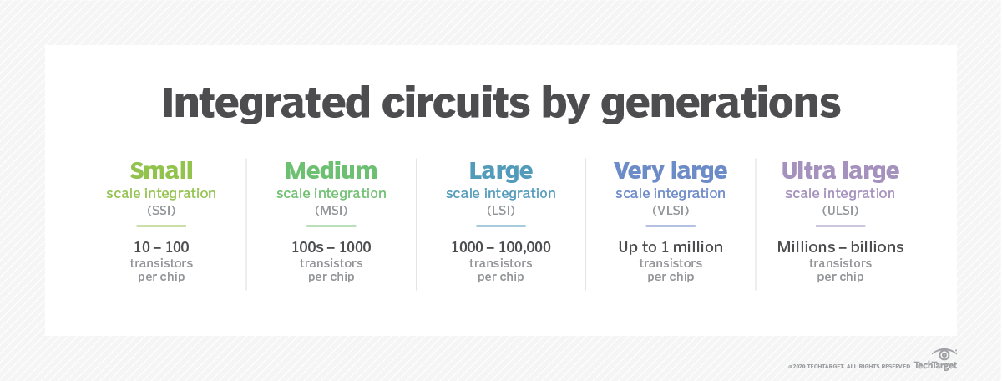

Slide 11
FOURTH GENERATION
1971- 2010
The microprocessor brought the fourth generation of computers, as thousands of integrated circuits equivalent to about millions of transistors were assembled and brought the whole central processing unit and other fundamental elements of the machine into a small chip called a microprocessor.
These computers used Very Large Scale Integrated circuits technology also called VLSI technology. After the invention, the microprocessor began to used in computing machines in the fourth and fifth generations of computers.
The first microprocessor was the Intel 4004, manufactured in 1971, initially for an electronic calculator. Whereas the computers of the first generation filled an entire room, while now the 4th generation ‘microprocessors’ fit in the palm of the hand.

Slide 12
The high-level language like C, C ++, Java, PHP, Python, Visual Basic, was utilized to compose programs in the computers of the fourth generation.
This generation of computers used an operating system based on the graphical user interface (GUI).
These computers were more faster and less expensive can be put on a table or desk. Which marked the era of personal computers.
Desktops, Laptops, Workstations, Tablets, Chromebooks, and Smartphones, are examples of the fourth generation of computers.

Slide 13
MICROPROCESSOR
Computer's CPU built on a single Integrated Circuit (IC) is called a microprocessor. It contains millions of tiny components like transistors, registers, and diodes that work together.
It perform various tasks involved in data processing as well as arithmetic and logical operations.
The microprocessor follows a sequence to execute the instruction: Fetch, Decode, and then Execute.
Initially, the instructions are stored in the storage memory of the computer in sequential order. The microprocessor fetches those instructions from the stored area (memory), then decodes it and executes those instructions till STOP instruction is met. Then, it sends the result in binary form to the output port. Between these processes, the register stores the temporary data and ALU (Arithmetic and Logic Unit) performs the computing functions.

Slide 14
Generation | Era | Chip size | Word size | Maximum memory size | core | Example
First | 1971-1973 | LSI | 4-bit | 1KB | Single | Intel 8080
Second | 1974-1978 | LSI | 8-bit | 1MB | Single | Intel 8085
Third | 1979-1980 | VLSI | 16-bit | 16MB | Single | Intel 8086
Forth | 1981-1995 | VLSI | 32-bit | 4GB | Single | Motorola 68030
Fifth | 1995-present | SLSI | 64-bit | 64GB | Multicore | Pentium

Slide 15
FIFTH GENERATION
Artificial intelligence is the name of the fifth as well as the latest generation of computers based on ULSI (Ultra Large Scale Integration) technology.
Fifth-generation computer technology is still in development, though there are some applications, such as voice recognition, that are being used today.
Computers are made portable, powerful, lightweight, comfortable with low electricity consumption.
This new information technology has greatly increased the size and working ability of the microprocessor, which has prompted the use of computers in the various fields of Entertainment, Accounting, Educational institutes, Film-making, Traffic-control, Business applications, and Hospitals, Engineering, Researches, Defense, etc.
That’s why a computer of the 5th generation is also known as the AI (Artificial Intelligence) generation of computers.

Slide 16
The processing speed in 5th generation computers is quite high, can perform billions of calculations in a second.
Invention of the operating system such as Windows and Macintosh.
The larger goals in AI is to indulge devices to:
Understand natural language
Recognize human speech
See the world in three-dimensional perspective
Play interactive games
Implement expert input in medical and other complex fields
Exercise heuristic classification analysis
Implement neural networks

